Slide 1

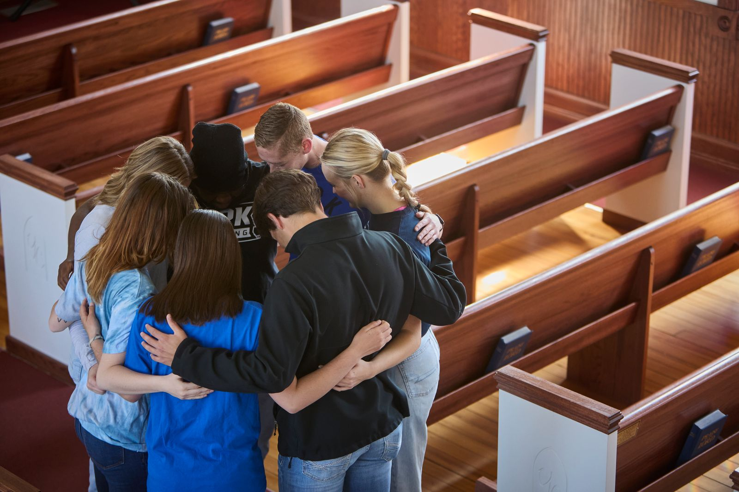

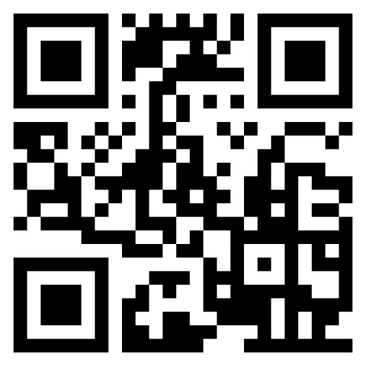


Ministry Growth & Development
Faith-Based | Purpose-Driven | Impactful
Prepare to strengthen churches and foster sustainable ministry growth through a new concentration in the Master’s of Global & Organizational Leadership, featuring three master’s-level courses in 8-week, 100% online terms.
online.york.edu/apply
Register by August 26, 2026
online@york.edu

